Slide 1
Querying in Druid
Jay Wang
14 April 2013
CPS 394 Research Independent Study

Slide 2
Files Involved
data.txt
query.body
realtime.spec
start-firehose.sh
run-queries.sh

Slide 3

data.txt
Example in our project: appevents.txt
This is where you specify the structure of your data
You can use a template described here or you can just enter in the raw data you want firehose to push
Sample data stream:

Slide 4
query.body
Example in our project: event_counts_query.body
This is where you define your query
Here you specify the queryType, dataSource, granularity, dimensions, aggregations, post-aggregations, and intervals
Specific information to be found here

Slide 5
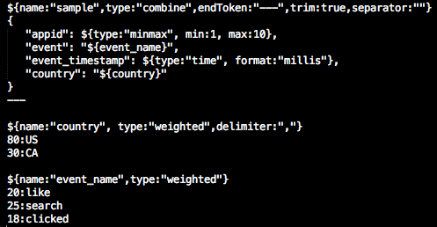
Trial I
Firehose has been set to generate @ 10/sec
Here is what the data set looks like:

Slide 6
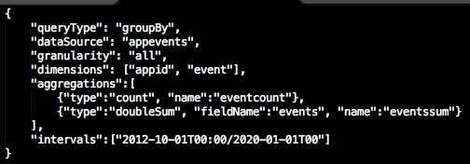

Trial I cont.
Here is what the query looks like:
Here is what the schema looks like:

Slide 7
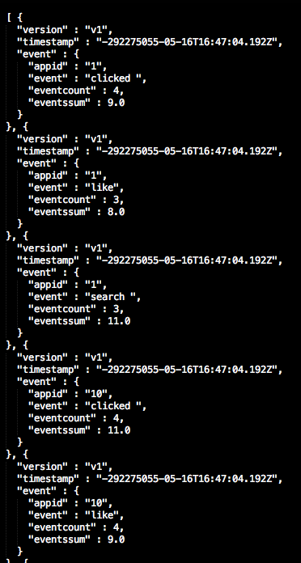
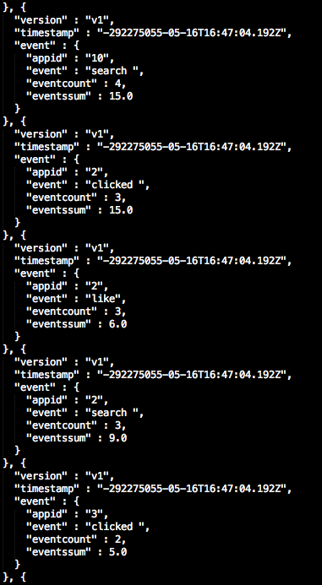
Trial I results
Here is a sampling of the results:

Slide 8
Questions
Q: Why will eventssum >= eventcount?
A: It lies in how Druid handles aggregations.
In short, eventssum is the number of events with the specified dimensions
eventcount is the number of aggregated rows in memory
If Druid gets duplicate data entities, it will aggregate them into one row and assign a count to that row
The count is the number of entities
We are using a count aggregator as defined in the schema

Slide 9
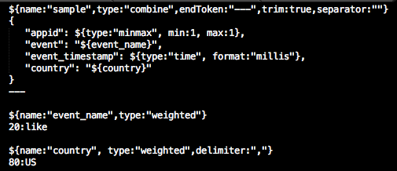
Trial II
Objective: Feed Druid the same data to make the eventcount equal 1.
New data set:
As can be seen, every event will have an appid of “1”, event of “like” and country of “US”

Slide 10
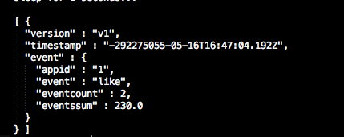
Trial II results
The query and schema will remain the same.
Results:
Is this what we would expect?
Why does the eventcount = 2?

Slide 11
Questions
The results make sense.
If you go back to the schema for this query, the indexGranularity is set at “minute”
This means at the end of every minute, Druid will perform an aggregation no matter what
Ultimately, this means that the timestamps for these data bits span two minutes
Note: Druid aggregates on all of the data’s fields, NOT on dimensions
If country varied from [“US”, “CA”, “EN”], Druid would aggregate separately for {appid:1, event:like, country:US} and {appid:1, event:like, country:CA}, etc.

Slide 12
Stress Tests
Trying to write a stress test for Druid
“stress” is based on two things:
the amount of data to process over
the complexity of the query
Problem:
there is a cap as to how fast firehose can push data to kafka (it’s generally around <1.5K/sec
i.e. you can’t feasibly push 1M tweets/sec

Slide 13
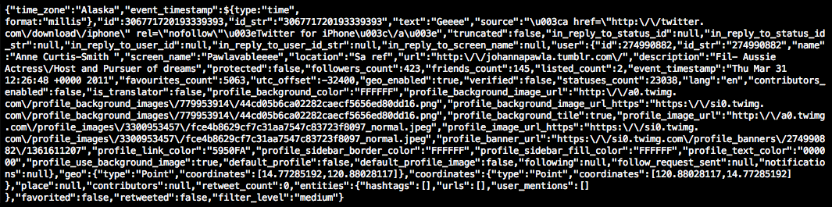
Trial III
Firehose rate set to 1M/sec (won’t actually reach that speed, it peak out much sooner)
I will let firehose run for 30 min
Data file is tweets.txt
Sample Tweet:

Slide 14

Trial III cont.
Running the same query, except my dimensions will be [“id”, “id_str”, “text”]
Schema will remain the same
I ended up running firehose for 15.4 minutes (my computer began running out of memory)

Slide 15

Stress Success
Firehose ended up pushing 1.2M tweets
Queries ended up taking almost 14 seconds
Exact firehose.log and queries.log file available
Conclusion: definitely possible to “stress druid”

Slide 16
Issues
Druid has limited ability to query over nested dimensions
If still running and the data file has finished processing, firehose will start over (should be easy fix)
No way to pause firehose when data file is finished and then restart firehose when more data is added to data file

Slide 17
Moving Forward
For these examples, I have used:
queryType: groupBy
there also exist: search, timeSeries, timeBoundary
aggregations: count and doubleSum
there also exist: minMax, longSum
There are other cool features as well all detailed here

